Slide 1

Leveraging CIS Benchmarks™
to Detect and Prevent Top InfoSec Threats
Presented by:
Jesse Moore, Sr. Cybersecurity Advisor
UW Office of the CISO; UW Bothell
Resources: https://bit.ly/CISO-July

Slide 2

(Disclaimer)
WARNING…
The following presentation contains my thoughts, ideas and opinions. They do not represent those of my current or past employers.
Any events, characters and company depicted in the course of this presentation are purely fictitious.
Any similarity to actual events, characters and company is merely coincidental. Like South Park!
Do not use these tactics/techniques presented for evil.

Slide 3

Together We Can Defend!
Security depends on US.
Yep, more stuff to do…
Notes:
Managers sending this info to Admins of Domains, OU Admins, Networks Engineers, OS or Workstations admins, etc so that they will be aware there are Security best practices and an easy button via GPOs

Slide 4


Agenda
Membership to CIS
Red Canary Threat Detection Report
Leveraging CIS Benchmarks & GPOs

Slide 5

WHO Am I?
Previously:
Threat Detection and Response Team @ UW Medicine.
Currently:
Sr. Cybersecurity Advisor @UW Bothell
Education:
Bachelor’s of Science IT Security
GIAC Penetration Tester | Forensic Analyst
https://www.linkedin.com/in/jessefmoore/

Slide 6

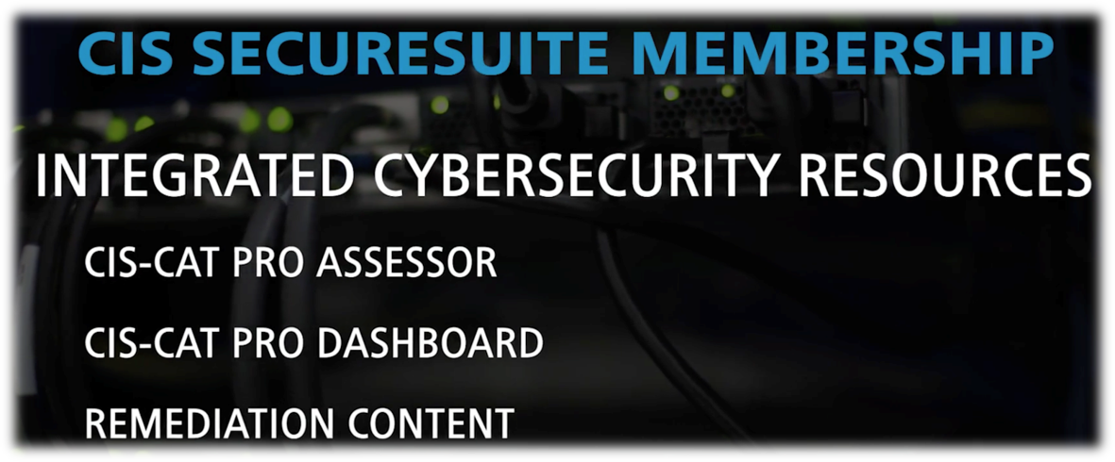
CIS Membership…
What exactly is that?
GPO – Group Policy Object
Reference: https://www.cisecurity.org/cis-securesuite/benefits/
Notes:
https://wiki.cac.washington.edu/display/~moorej1@washington.edu/Hunt+with+Kansa+or+GRR+or+Tanium
Remediation kit
Build kit

Slide 7
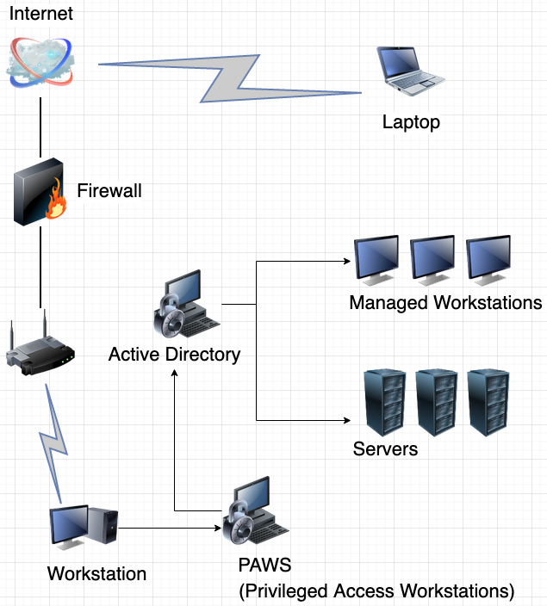


GPO (Group Policy Object) Impact?
Notes:
https://wiki.cac.washington.edu/display/~moorej1@washington.edu/Hunt+with+Kansa+or+GRR+or+Tanium

Slide 8
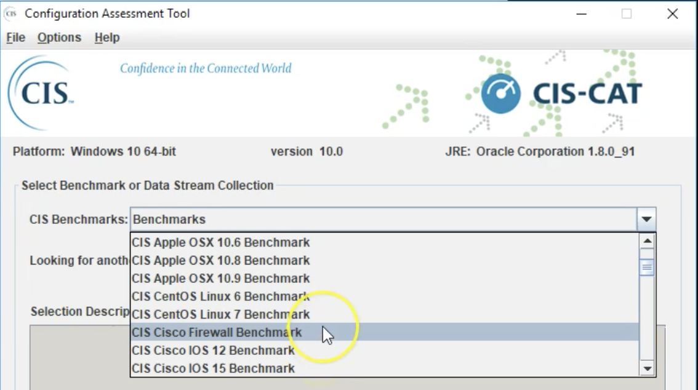
Being prepared…what can I do?
Reference: https://screencast-o-matic.com/watch/cFj6F7qjgf
Notes:
Automate finding issues
Provide Benchmarks of secure configurations
Automate GPO at domain level
Next Slide: To put this with a Security Framework… like NIST, ISO 2700, etc I choose to reference CIS Controls as they provide a lot of support to securing…

Slide 9
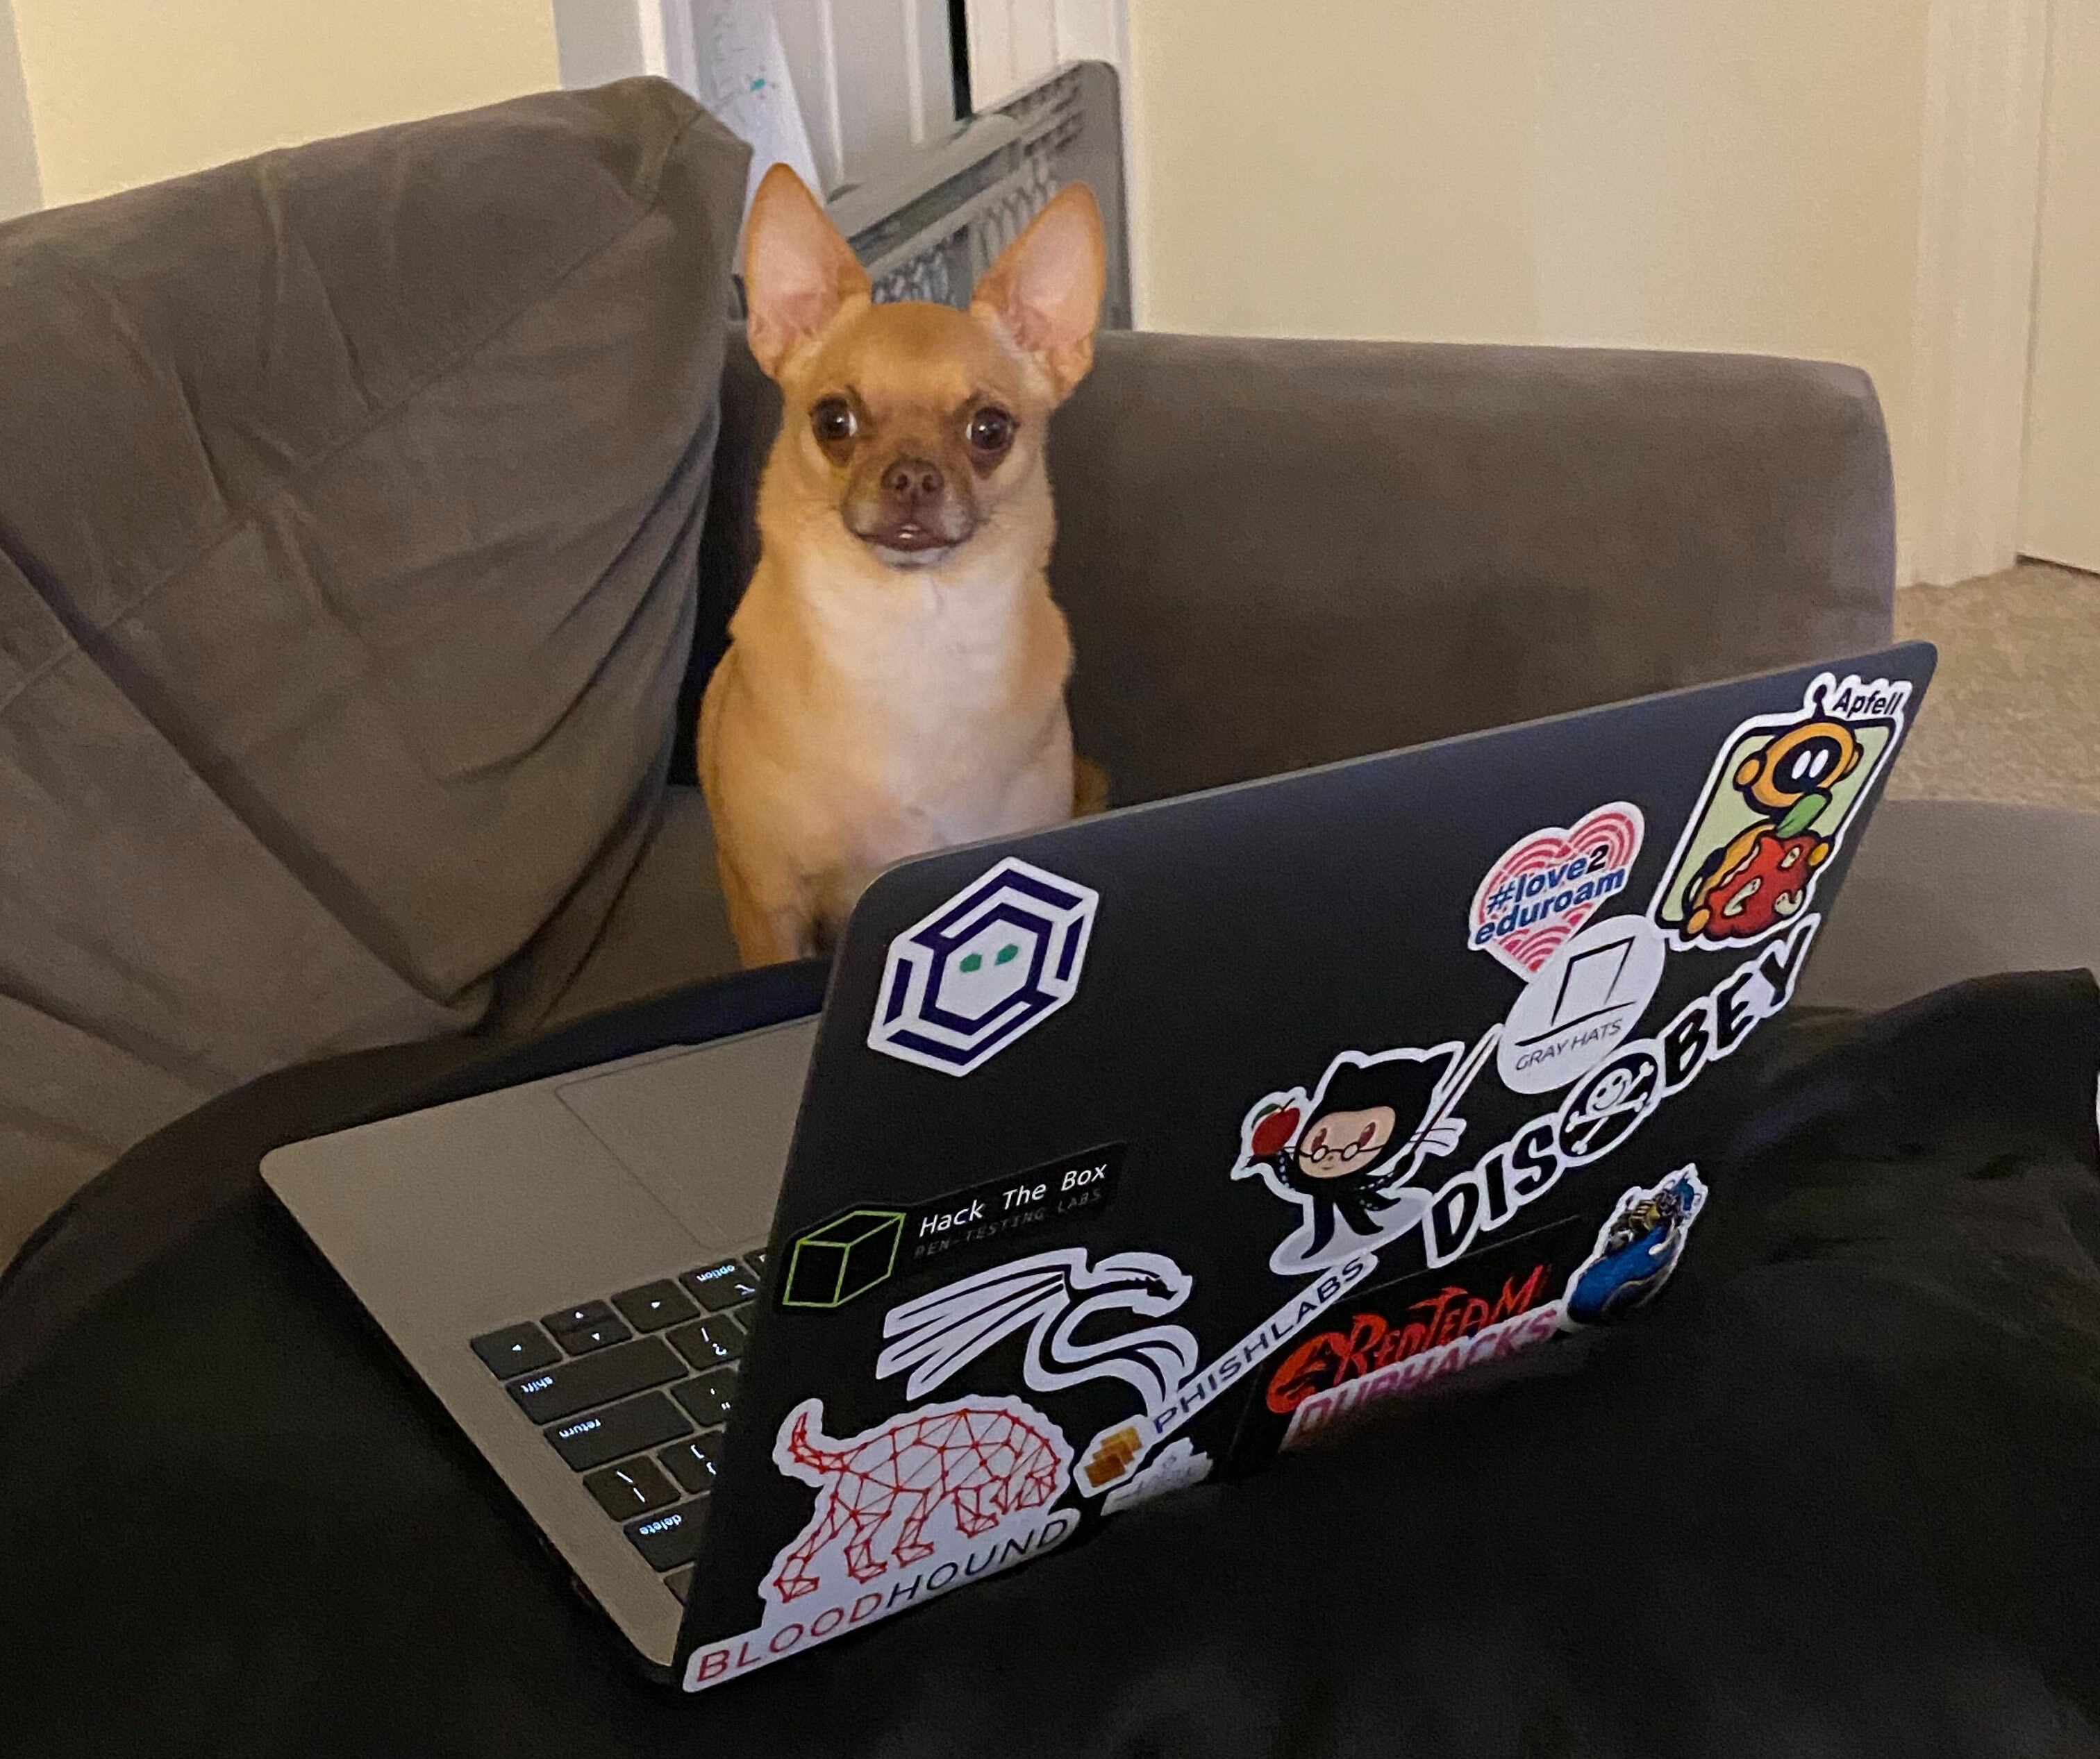
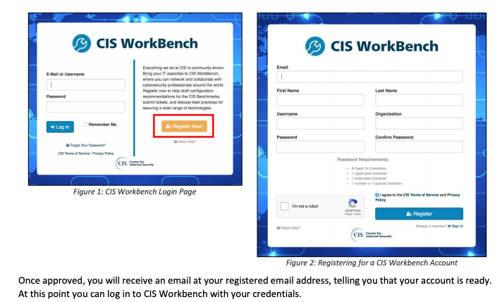
How do I sign up?
To register, visit:
https://workbench.cisecurity.org
Use your uw.edu email address

Slide 10
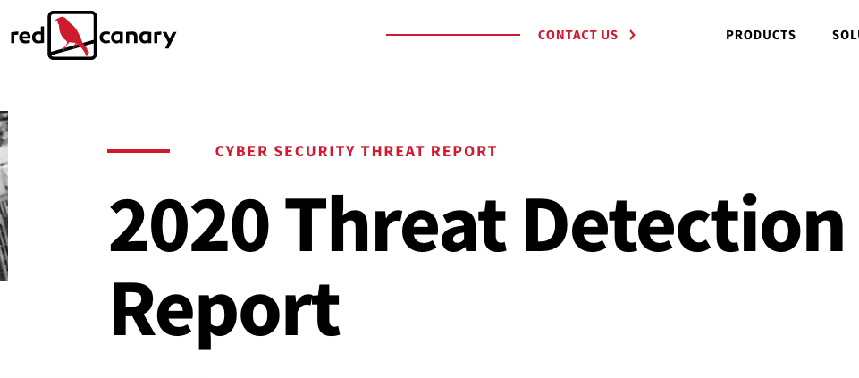
https://redcanary.com/threat-detection-report/

Slide 11
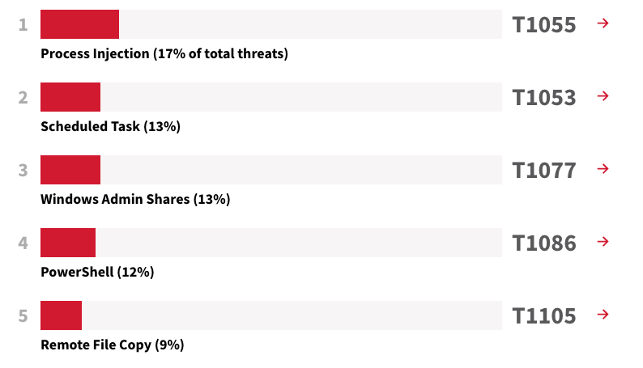
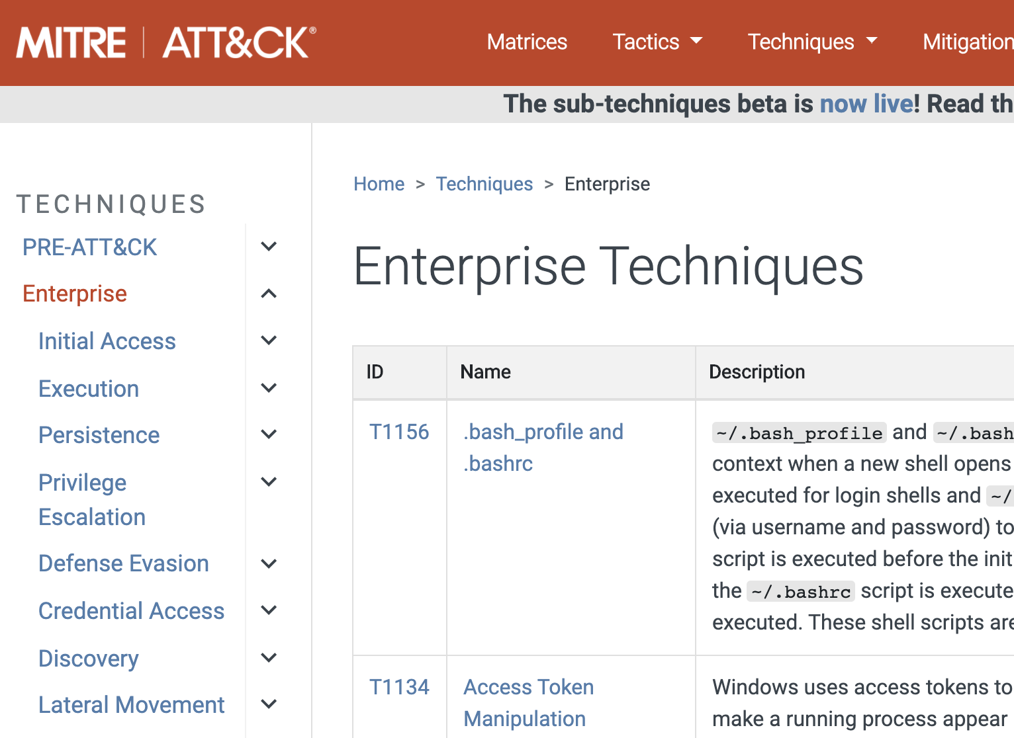
TOP Post-Exploit Techniques
Notes:
https://attack.mitre.org/tactics/enterprise/

Slide 12
Post-Exploit
Get in
Stay in
(Post-exploit)
Look around
(Post-exploit)
Phishing
Password guess
Secure config weakness
Command & Control
Persistence
Lateral movement
Search drives
Search data

Slide 13
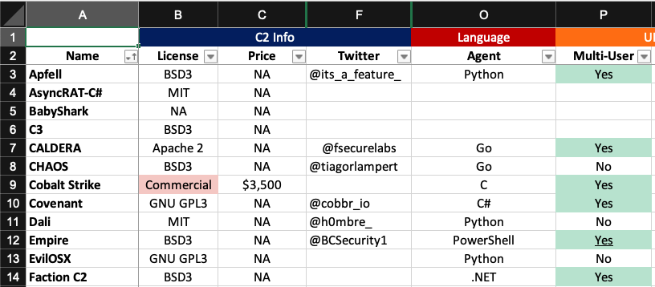
Adversary | C2Matrix
Reference:
https://www.thec2matrix.com/

Slide 14
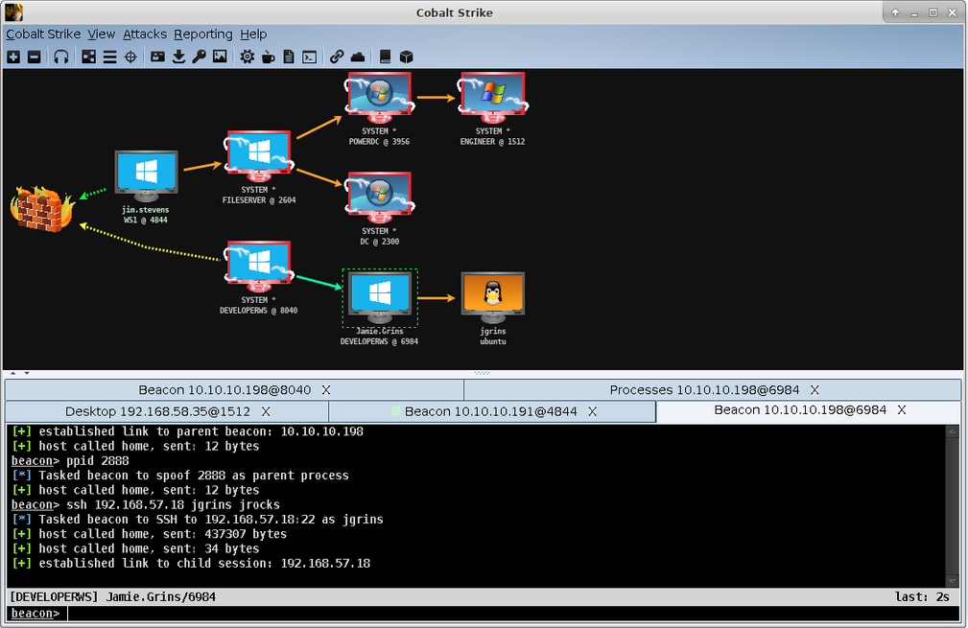
Command & Control GUI
Notes:
Scan to find… and right click to attack (RDP, SSH, SMB, etc)

Slide 15


DEMO: Adversary Technique
WDIGEST, keeping passwords on Machine in clear text.
Wdigest turned on in PC:
https://www.youtube.com/watch?v=gCV7Mirrc0c
Notes:
StickyKeys: https://screencast-o-matic.com/watch/cYiVcu5Ytt
StickyKey via APT:
https://attack.mitre.org/techniques/T1015/
ScheduledTask APT: https://attack.mitre.org/techniques/T1053/
•Schedule Task:
https://screencast-o-matic.com/watch/cYine15ZDT
https://attack.mitre.org/techniques/T1053/
https://www.youtube.com/watch?v=gCV7Mirrc0c

Slide 16
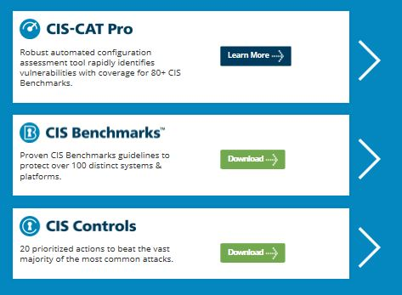
Being prepared…what can I do?
Reference:
https://learn.cisecurity.org/cis-cat-landing-page

Slide 17
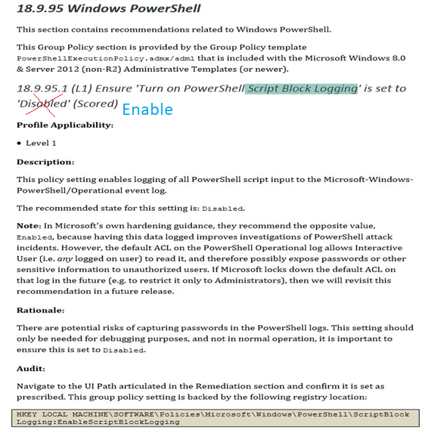
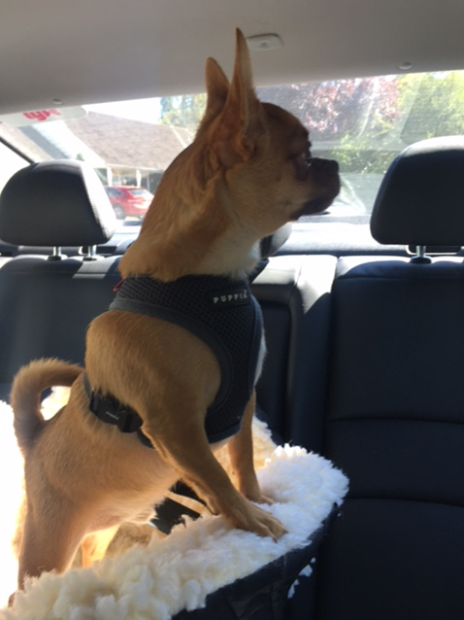
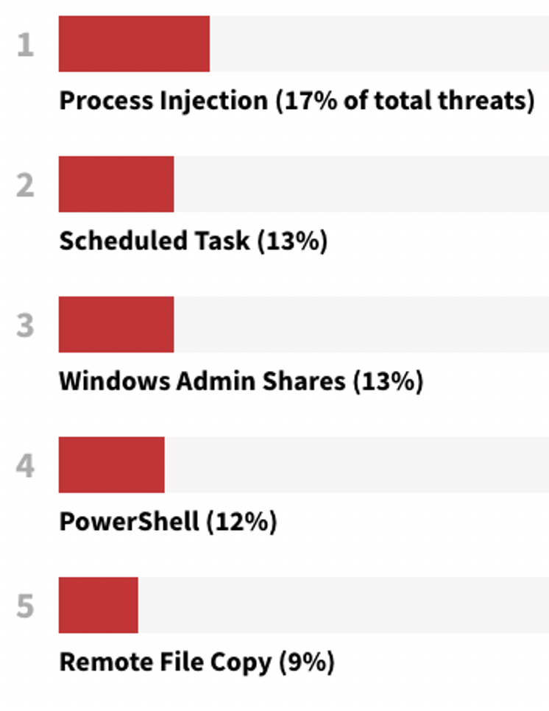
Enable
Windows PowerShell Script block logging
And adjust…
Notes:
OR just do SYSMON

Slide 18
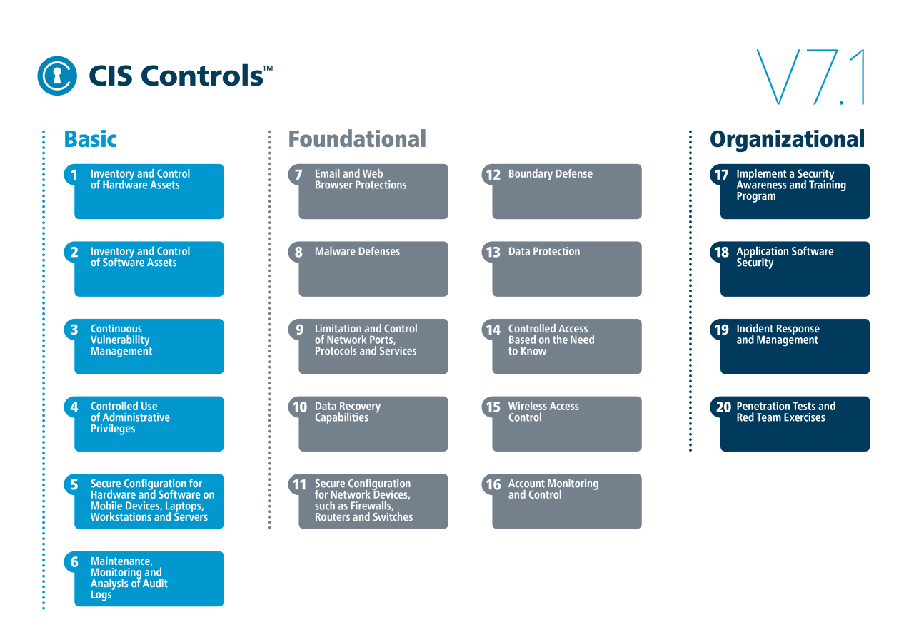
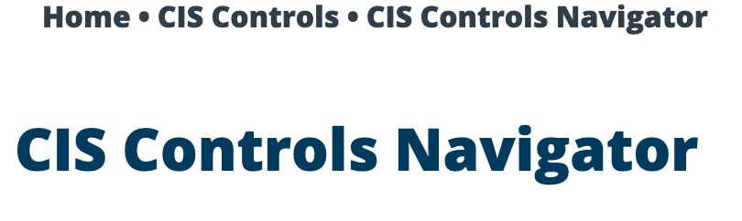

Slide 19
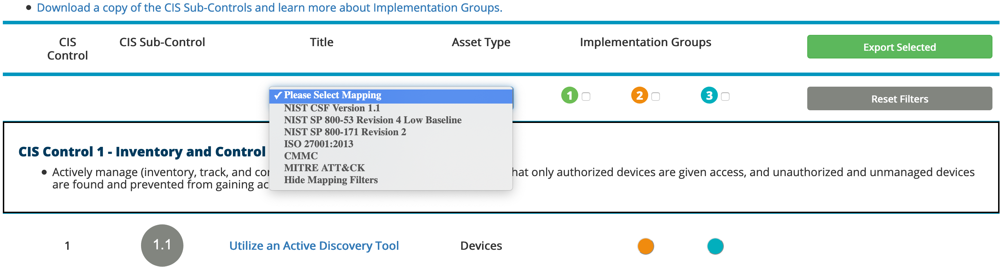

Slide 20

The End… until next time.
¯\_(ツ)_/¯
1. Sign Up for CIS Workbench.
Get CIS-CAT & GPOs
2. Sign up for CIS Secure GPO Workshop
Send an email to CISO@uw.edu
Subject “Secure GPO Workshop”

Slide 21
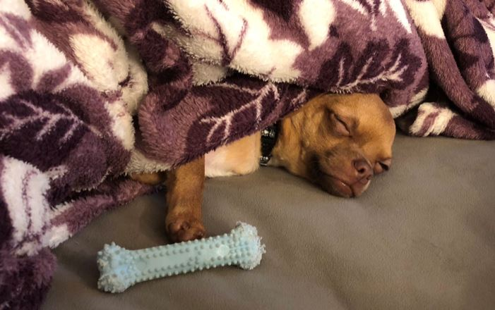
Yep, that was a lot…
Download
resources here:
https://bit.ly/CISO-July
Contact info: moorej1@uw.edu
Twitter: @jessefmoore

